Slide 1
Web Engineering Lect 3 (HTML)
Instructor: Faheem Shaukat
Meeting Hours
Wednesday and Thursday
12PM to 02PM

Slide 2
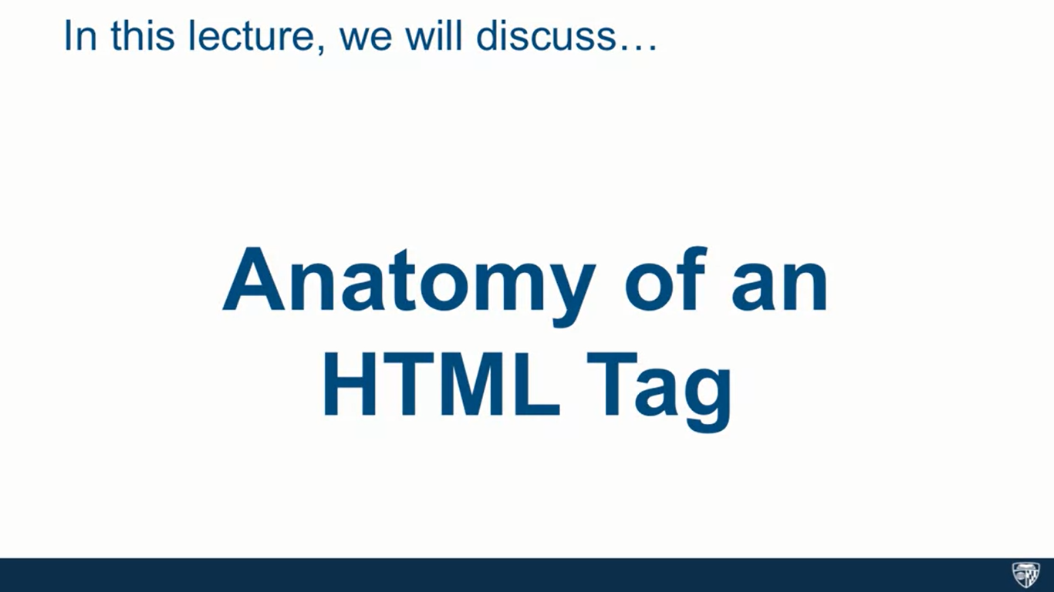

Slide 3
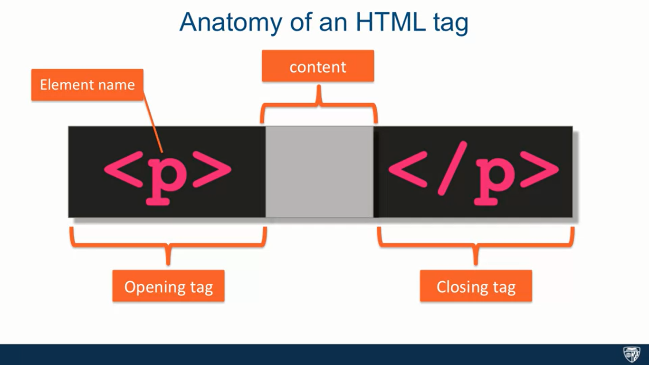

Slide 4
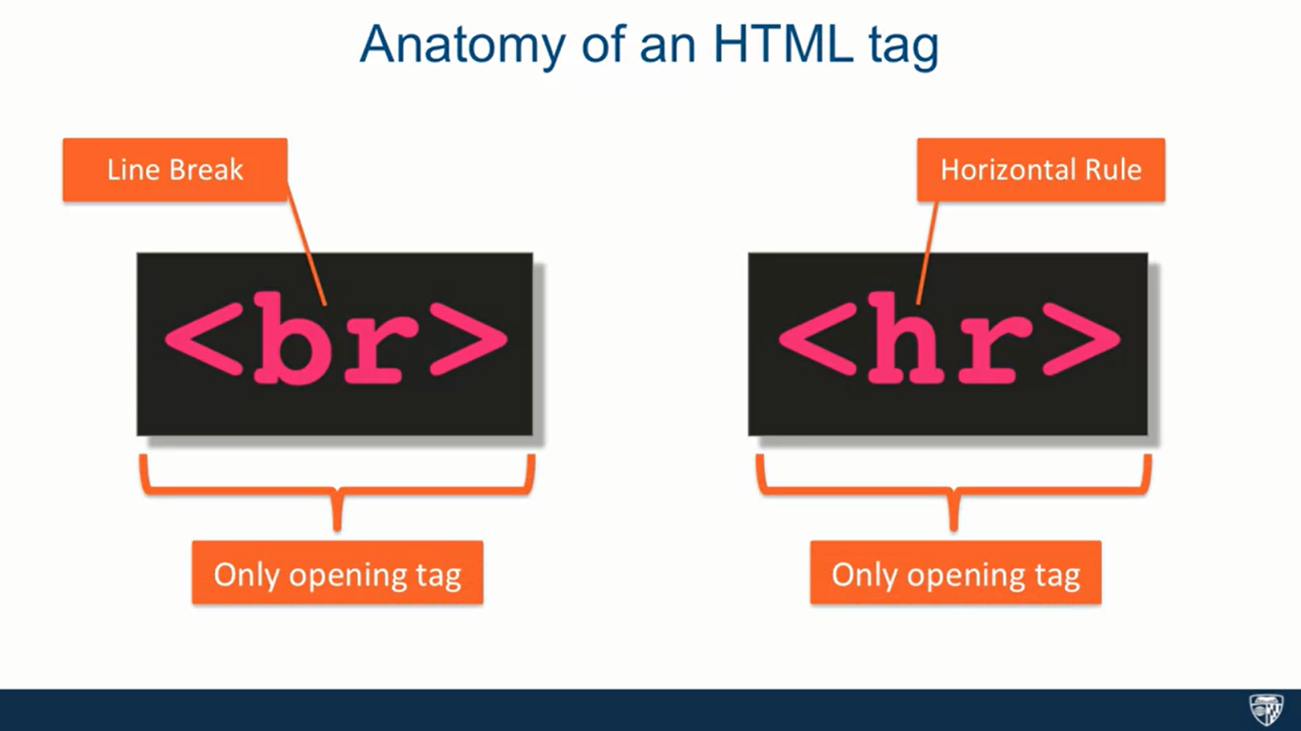

Slide 5
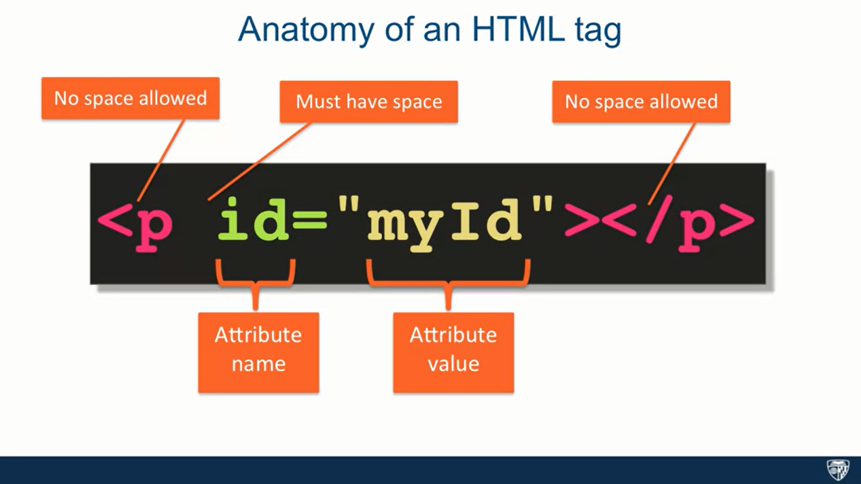

Slide 6
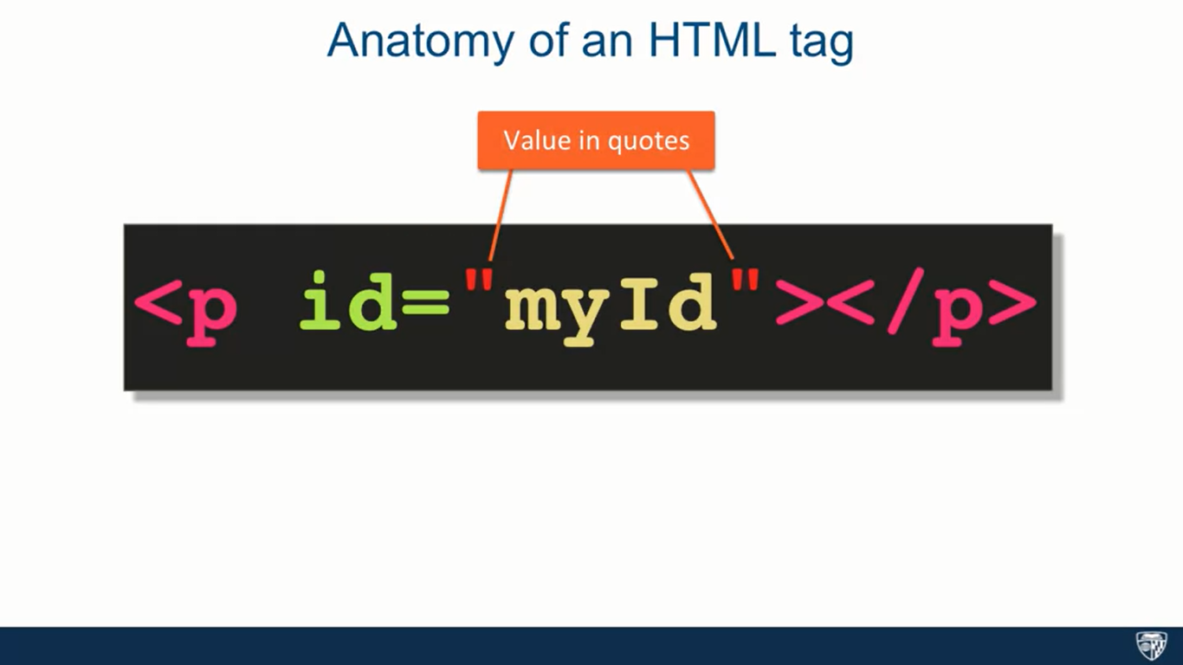

Slide 7


Slide 8
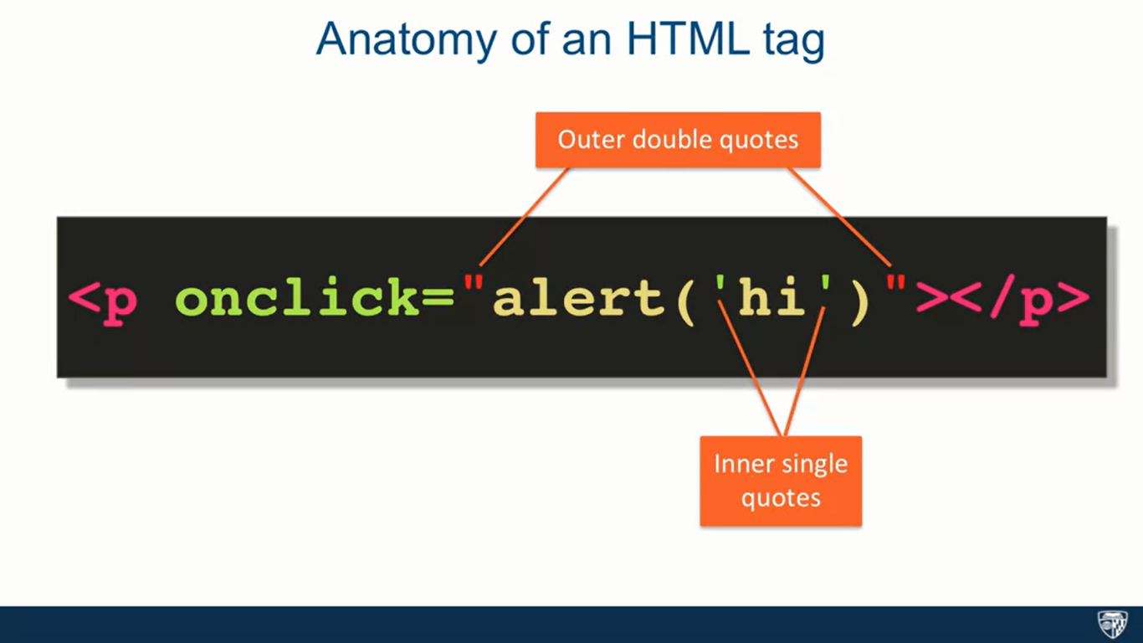

Slide 9
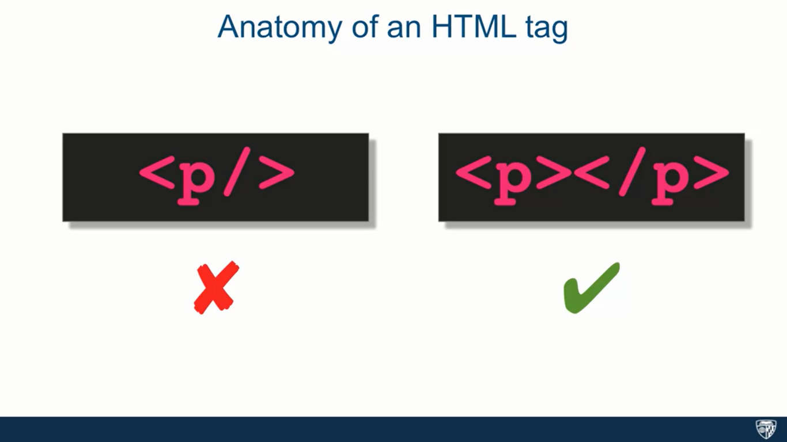

Slide 10
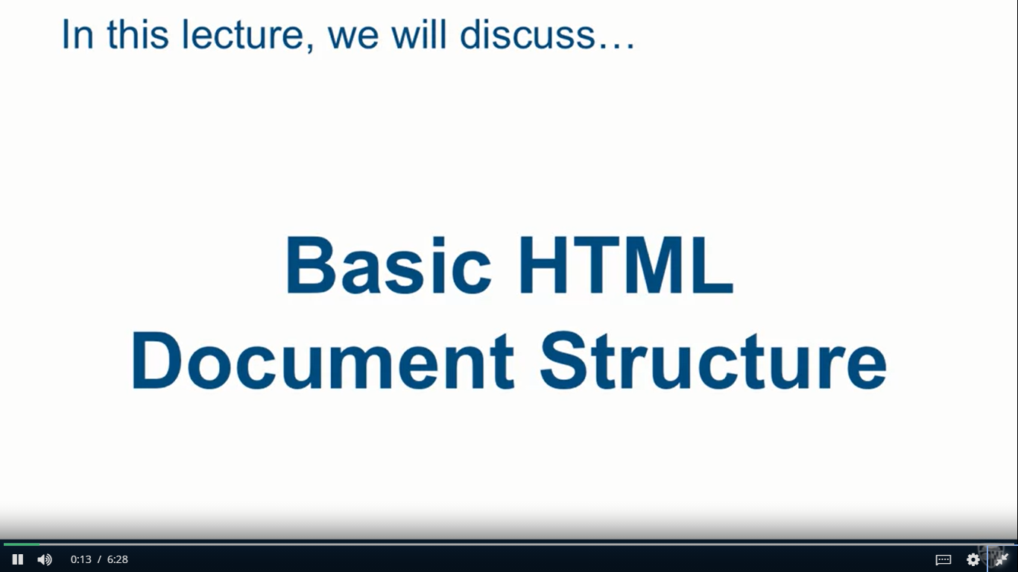

Slide 11
<!doctype html>
<html>
<head>
<meta charset="utf-8">
<title>Coursera is Cool!</title>
</head>
<body>
Coursera is so COOL! I am learning SO much!
</body>
</html>

Slide 12
<!doctype html>
<html>
<head>
<meta charset="utf-8">
<title>Coursera is Cool!</title>
</head>
<body>
<p>Coursera is so COOL! I am <span>learning SO much!</p></span>
</body>
</html>

Slide 13
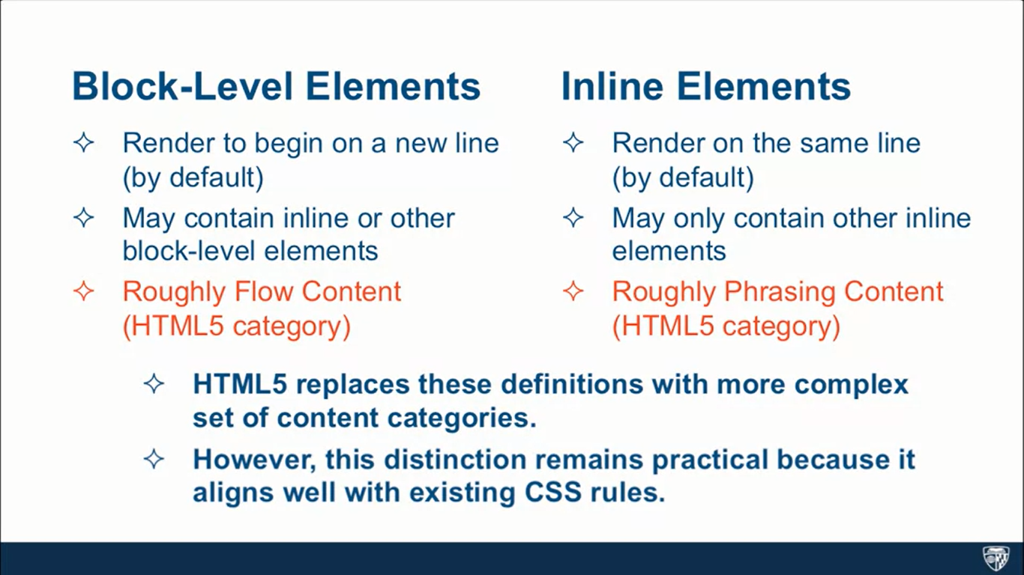

Slide 14
<!doctype html>
<html>
<head>
<meta charset="utf-8">
<title>div and span elements</title>
</head>
<body>
<div>*** DIV 1: Some content here ***</div>
<div>*** DIV 2: Following right after div 1 ***</div>
<span>*** SPAN 1: Following right after div 2 ***</span>
<div>
*** DIV 3: Following right after span 1
<span>*** SPAN 2: INSIDE div 3 ***</span>
Continue content of div 3 ***
</div>
</body>
</html>

Slide 15
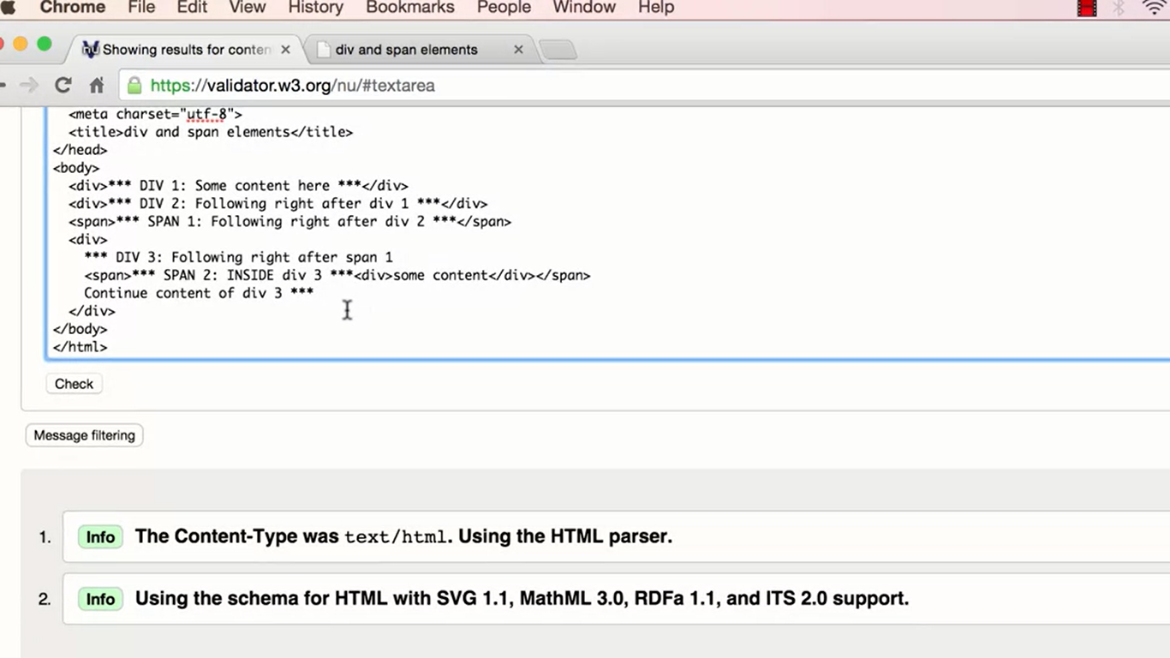

Slide 16
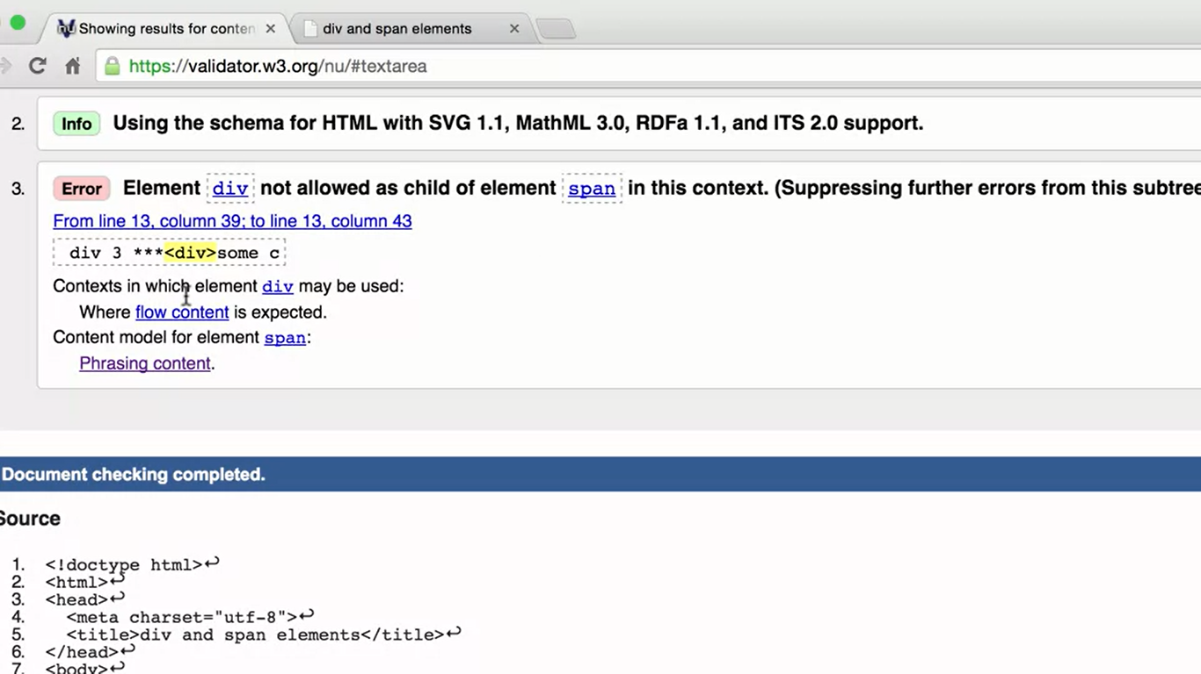

Slide 17
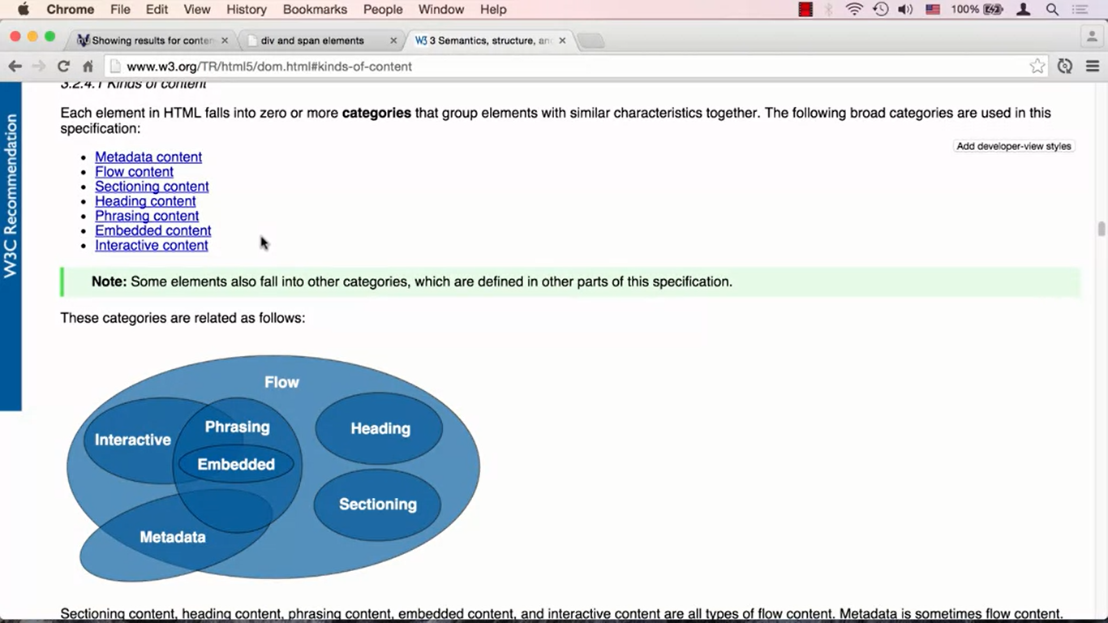

Slide 18
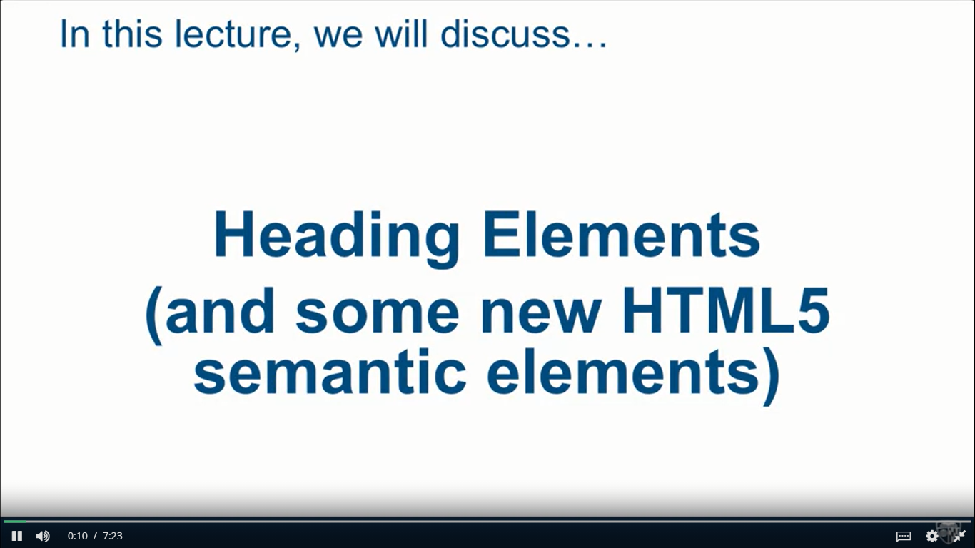

Slide 19
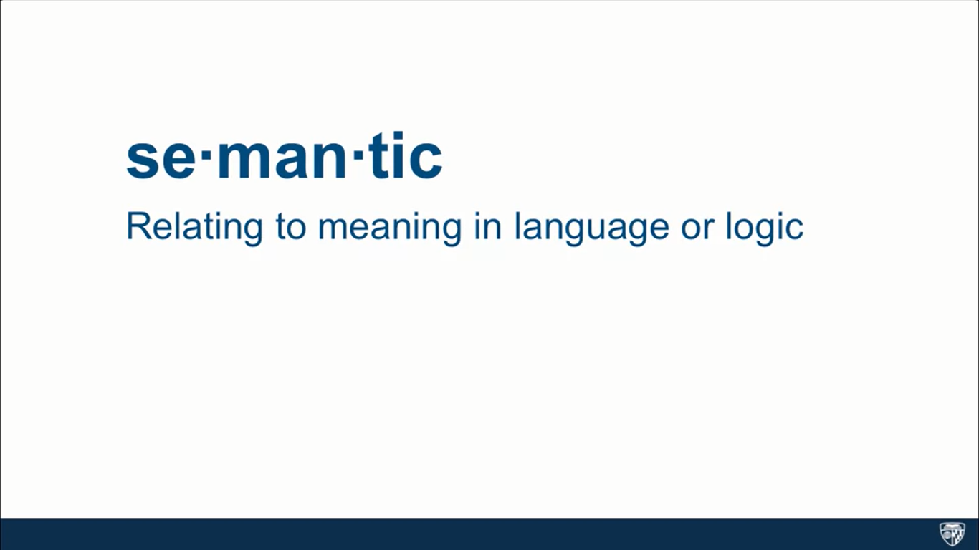

Slide 20
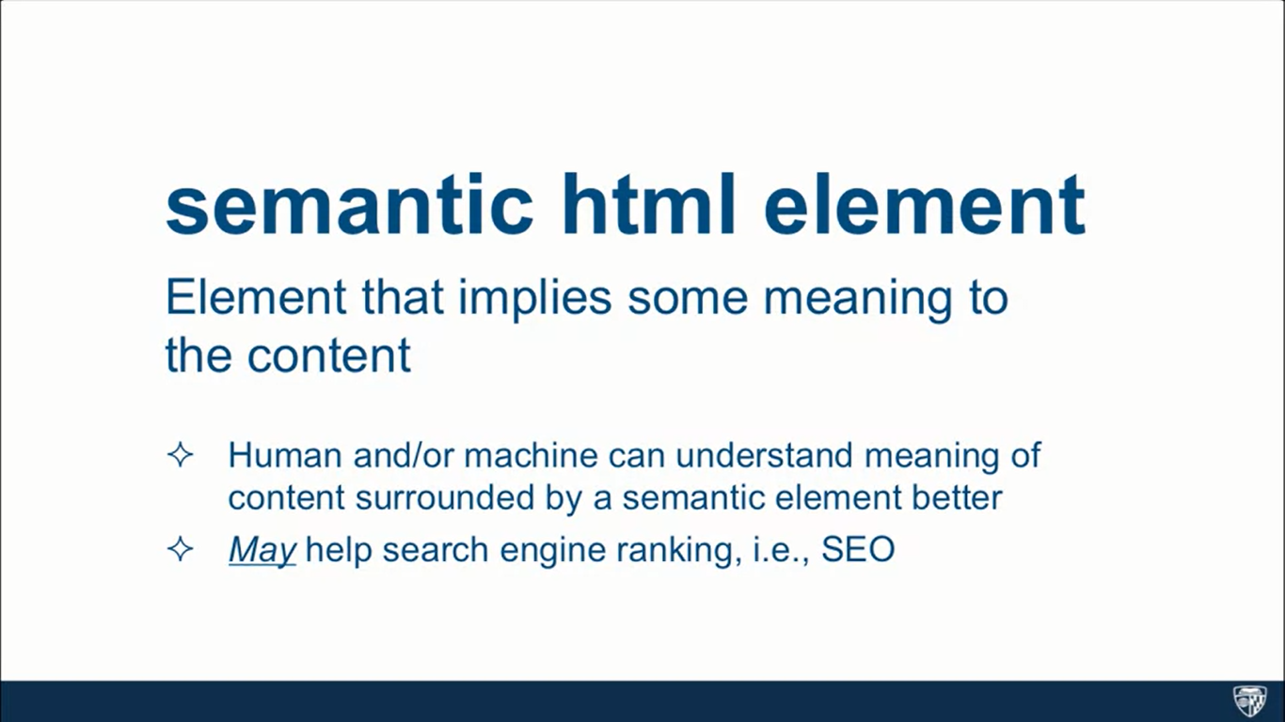

Slide 21
<body>
<header>
header element - Some header information goes here. Usually consists of company logo, some tag line, etc. Sometimes, navigation is contained in the header as well.
<nav>nav (short for navigation) element - Usually contains links to different parts of the web site.</nav>
</header>
<h1>Main Heading of the Page (hard not to have it)</h1>
<section>
Section 1
<article>Article 1</article>
<article>Article 2</article>
<article>Article 3</article>
</section>
<section>
Section 2
<article>Article 4</article>
<article>Article 5</article>
<article>Article 6</article>
<div>Regular DIV element</div>
</section>
<aside>
ASIDE - Some information that relates to the main topic, i.e., related posts.
</aside>
<footer>
JHU Copyright 2015
</footer>
</body>

Slide 22
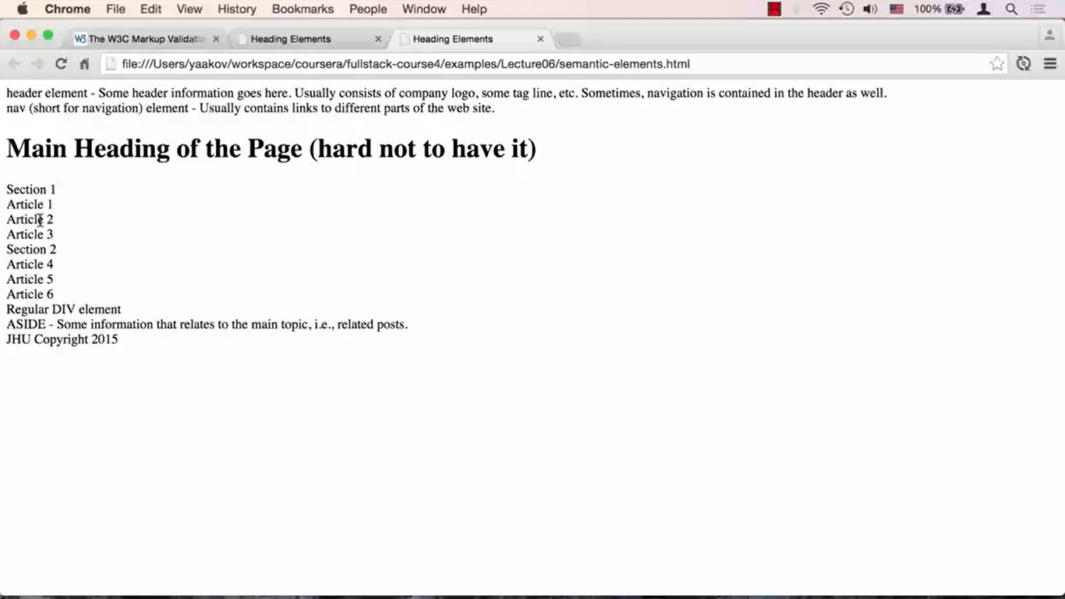

Slide 23
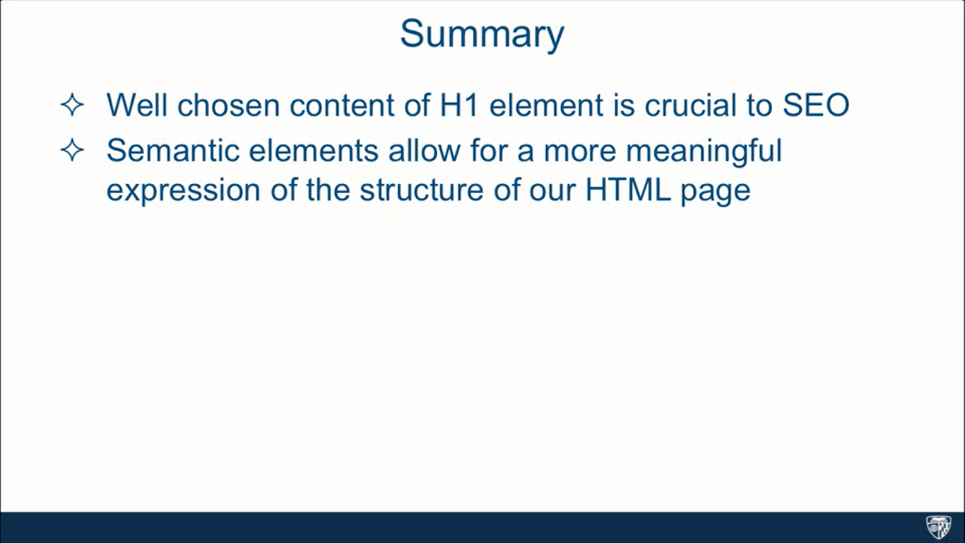

Slide 24
<body>
<h1>Unordered list</h1>
<div>
My typical dinner shopping list:
Milk
Donuts
Cookies
Chocolate
Sugar
Peanut Butter
Pepto Bismol
</div>
</body>

Slide 25
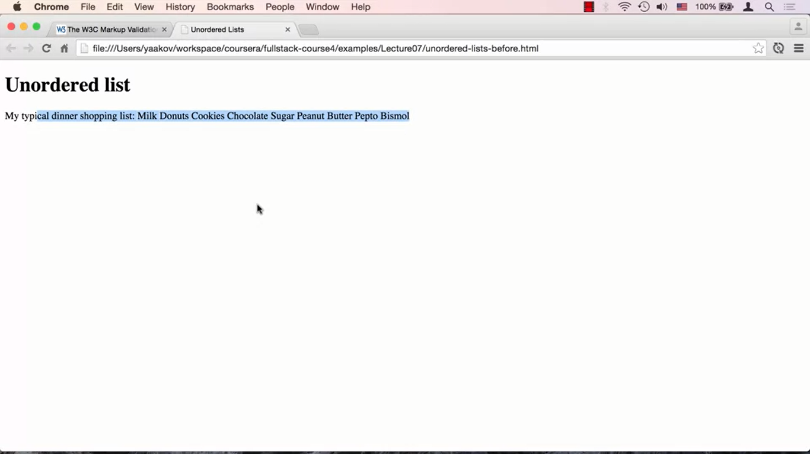

Slide 26
<body>
<h1>Unordered list</h1>
<div>
My typical dinner shopping list:
<ul>
<li>Milk</li>
<li>Donuts</li>
<li>Cookies
<ul>
<li>Chocolate</li>
<li>Sugar</li>
<li>Peanut Butter</li>
</ul>
</li>
<li>Pepto Bismol</li>
</ul>
</div>
</body>

Slide 27
